Slide 2
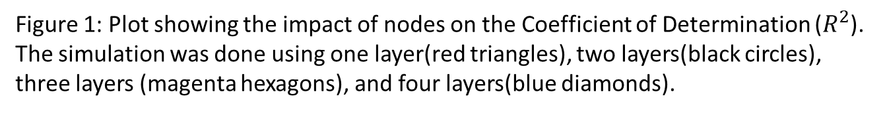
Figure 1: Plot showing the impact of nodes on the Coefficient of Determination ($R^{2}$).
The simulation was done using one layer(red triangles), two layers(black circles), three layers (magenta hexagons), and four layers(blue diamonds).

Slide 3
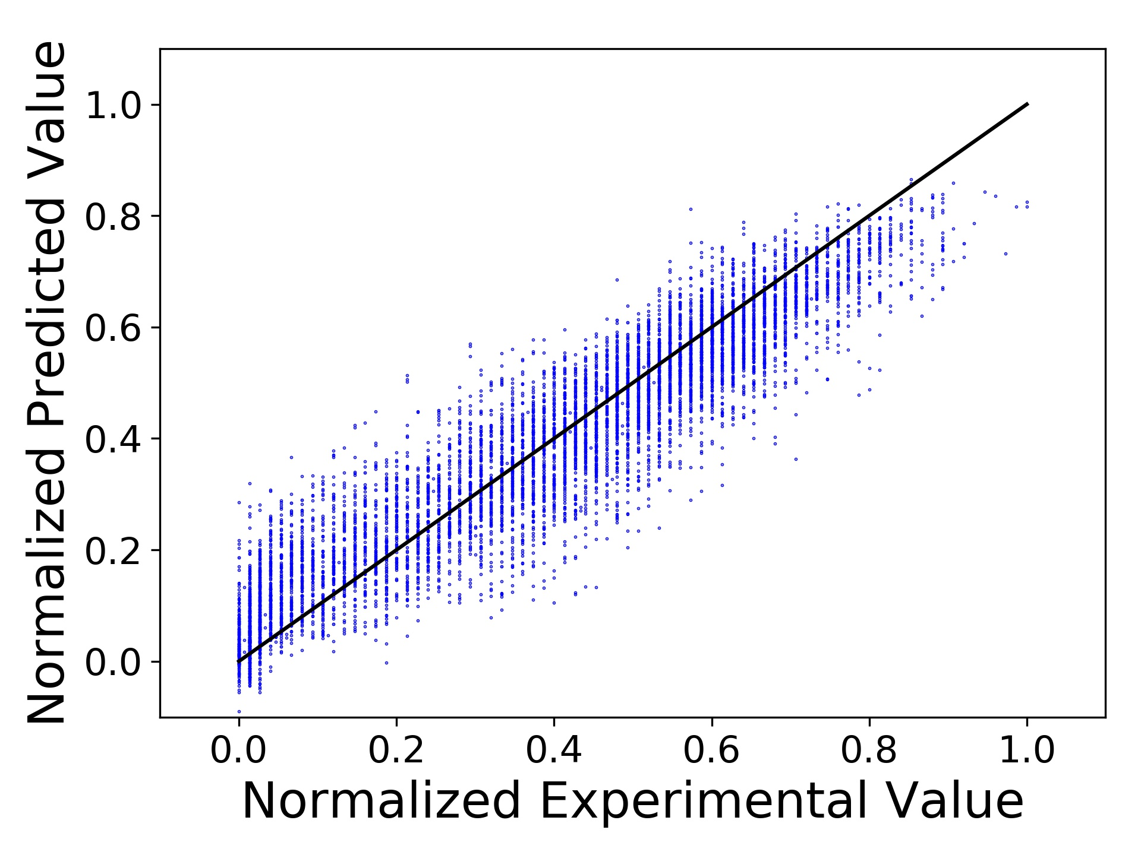
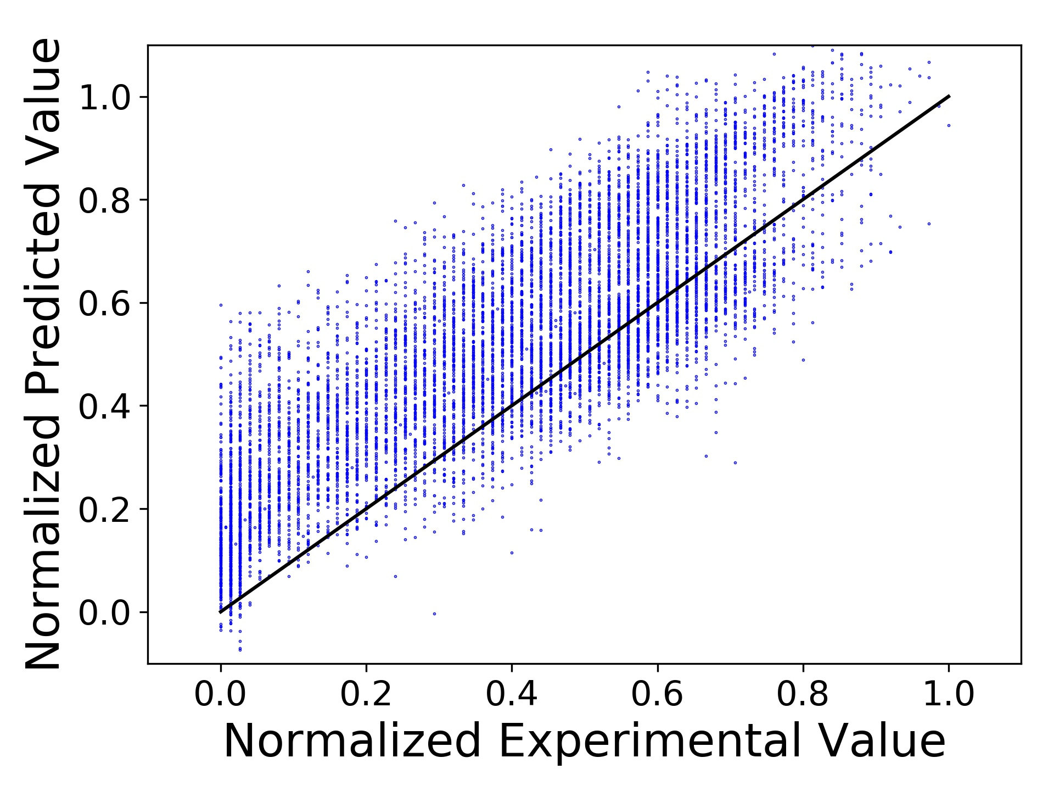
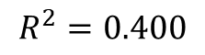
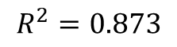
$$R^{2}=0.873$$
$$R^{2}=0.400$$
Figure 2: Parity plots showing the validation dataset (a) and showing the other sensor dataset (b). The neural network trained was 40 Nodes with 1 Hidden Layer

